Slide 1
Integración Numérica II
Dr. Luis Sanchez

Slide 2
Integration of Equations
Last class, the functions to be integrated numerically are in two forms:
A table of values. We are limited by the number of points that are given.
A function. We can generate as many values of f(x) as needed to attain acceptable accuracy.
Now, we will focus on two techniques that are designed to analyze functions:
Romberg integration
Gauss quadrature

Slide 3
Romberg Integration
Is based on successive application of the trapezoidal rule to attain efficient numerical integrals of functions.
Richardson’s Extrapolation/
Uses two estimates of an integral to compute a third and more accurate approximation.

Slide 4
The estimate and error associated with a multiple-application trapezoidal rule can be represented generally as
I =exact value of integral
I(h) =the approximation from an n segment application of trapezoidal rule with step size h
E(h) =the truncation error
Assumed constant regardless of step size

Slide 5
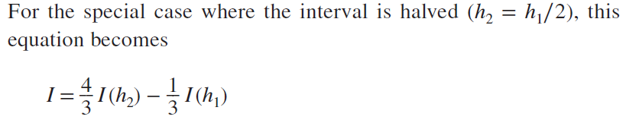
It can be shown (Ralston and Rabinowitz, 1978) that the error of this estimate is O(h⁴).
Improved estimate of the integral

Slide 6
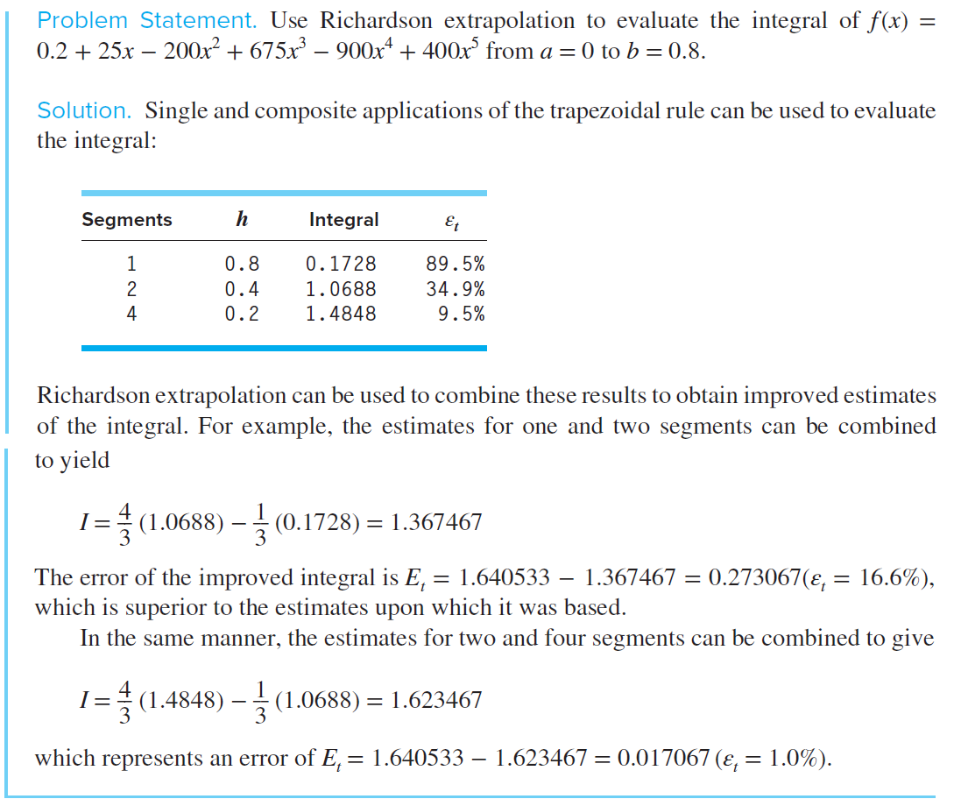

Slide 7
Richardson Extrapolation (cont)
For the cases where there are two O(h⁴) estimates and the interval is halved (h_{m}=h_{l}/2), an improved O(h⁶) estimate may be formed using:
For the cases where there are two O(h⁶) estimates and the interval is halved (h_{m}=h_{l}/2), an improved O(h⁸) estimate may be formed using:

Slide 8
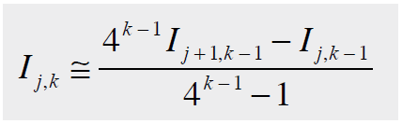
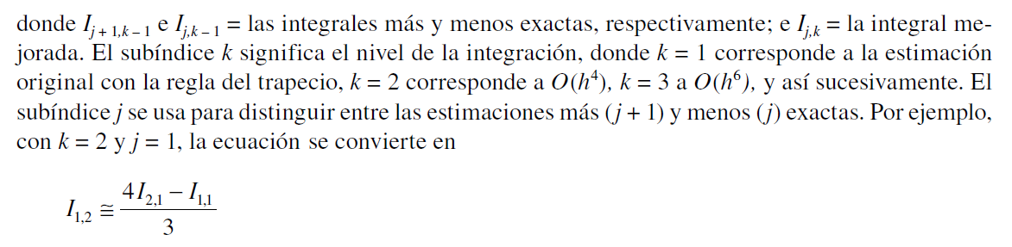
The Romberg Integration Algorithm

Slide 9
The Romberg Integration Algorithm
First column is obtained using Trapezoid Method
I(1,1)
I(2,1) | I(2,2)
I(3,1) | I(3,2) | I(3,3)
I(4,1) | I(4,2) | I(4,3) | I(4,4)
The other elements are obtained using the Romberg Method

Slide 10
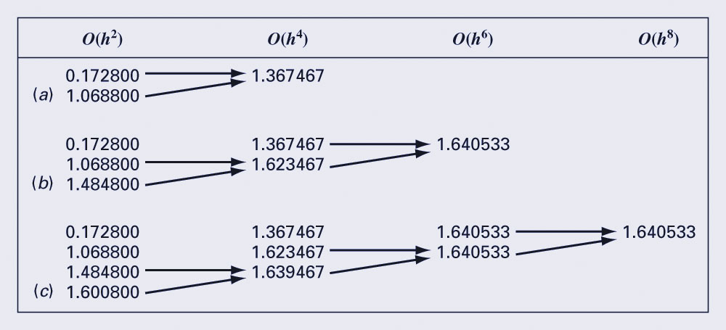
The Romberg Integration Algorithm
Graphical depiction of the sequence of integral estimates generated using Romberg integration.
(a) First iteration. (b) Second iteration. (c) Third iteration.

Slide 11
Gauss Quadrature

Slide 12
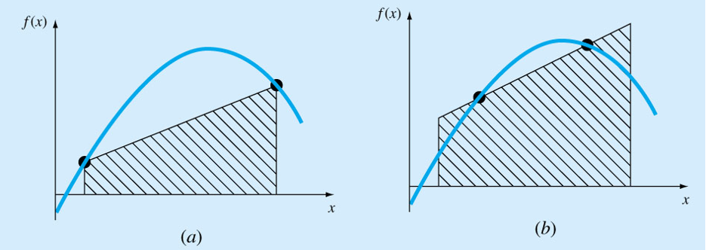
Gauss Quadrature
Gauss quadrature implements a strategy of positioning any two points on a curve to define a straight line that would balance the positive and negative errors.
Hence, the area evaluated under this straight line provides an improved estimate of the integral.

Slide 13
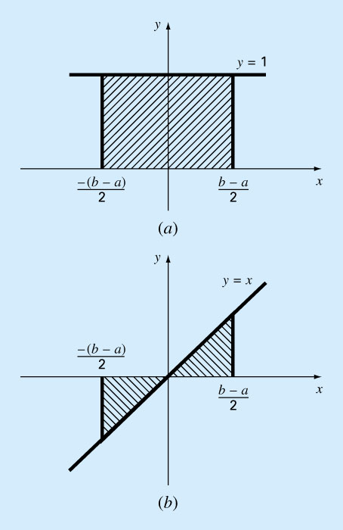
Method of Undetermined Coefficients/
The trapezoidal rule yields exact results when the function being integrated is a constant or a straight line, such as y=1 and y=x:
Solve simultaneously
Trapezoidal rule

Slide 14
Derivation of the Two-Point Gauss-Legendre Formula/
The object of Gauss quadrature is to determine the equations of the form
However, in contrast to trapezoidal rule that uses fixed end points a and b, the function arguments x₀ and x₁ are not fixed end points but unknowns.
Thus, four unknowns to be evaluated require four conditions.
First two conditions are obtained by assuming that the above eqn. for I fits the integral of a constant and a linear function exactly.
The other two conditions are obtained by extending this reasoning to a parabolic and a cubic functions.

Slide 15
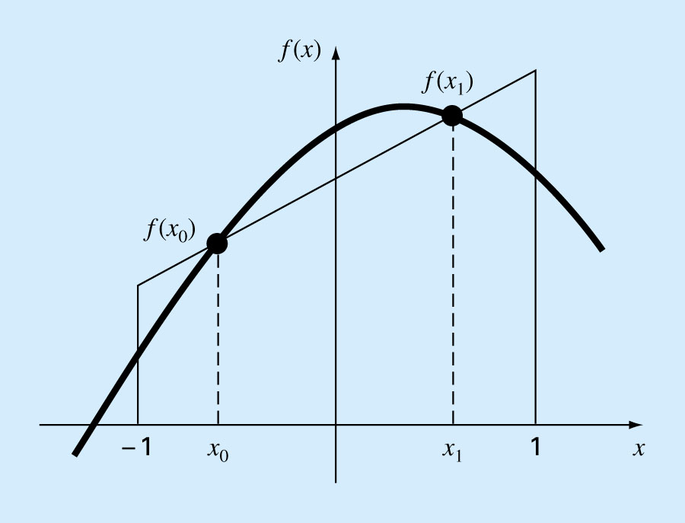
Solved simultaneously
Yields an integral estimate that is third order accurate

Slide 16
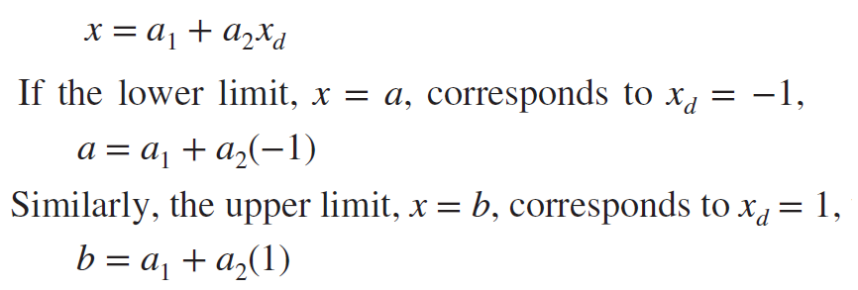
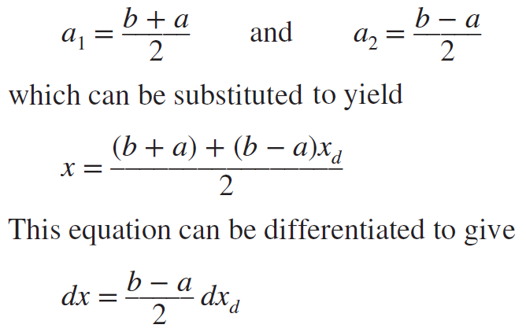
Two points Gauss-Legendre Formula
Since we used limits for the previous integration from –1 to 1 and the actual limits are usually from a to b, then we need first to transform both the function and the integration from the x-system to the x_{d}-system
f(x)
f(x)
f(x₁)
f(x_{o})
x
a
x_{o}
x₁
b
x
-1
1

Slide 17
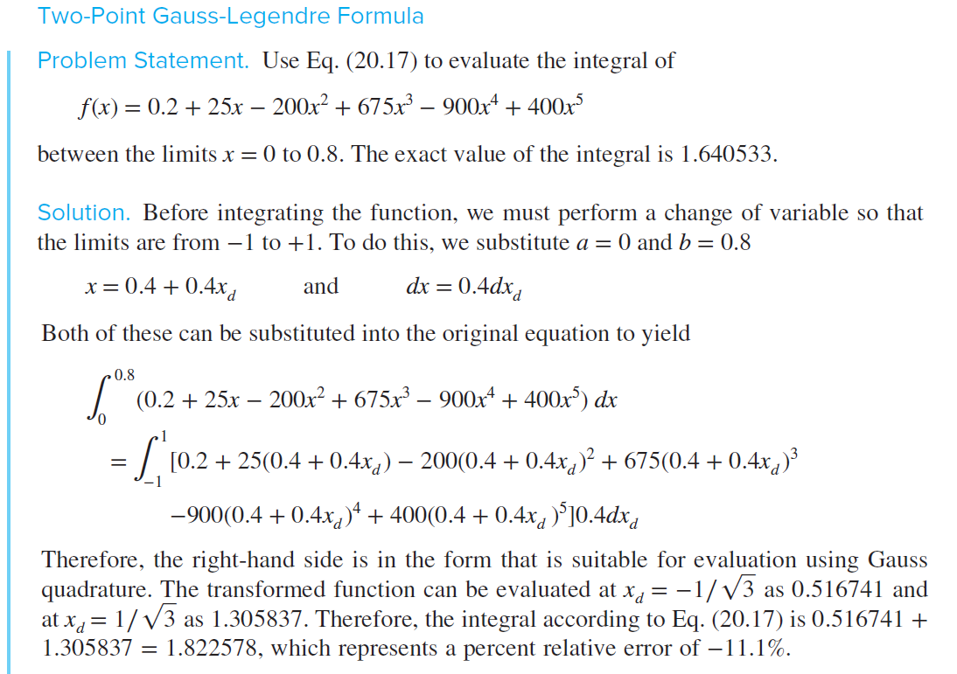

Slide 18
Higher-Points Gauss-Legendre Formula

Slide 19
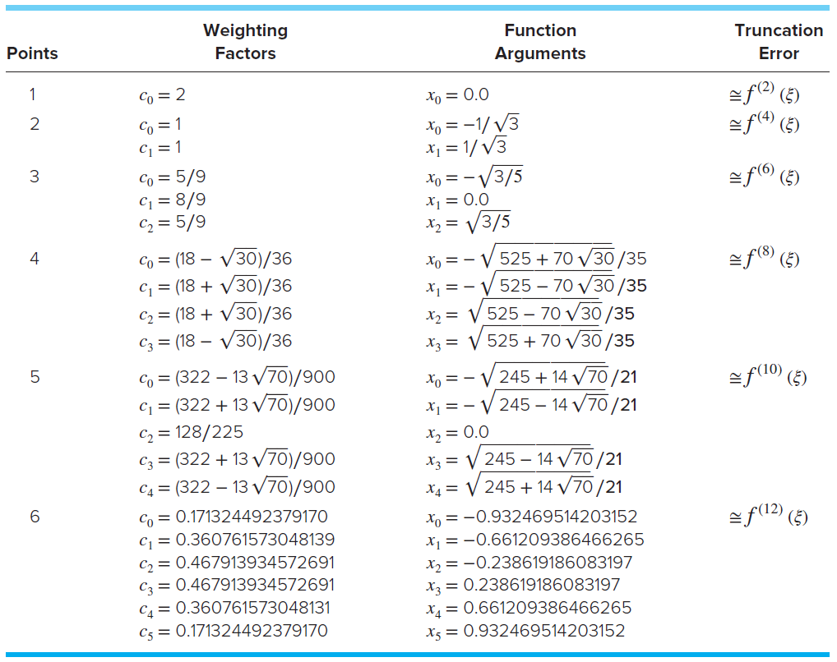
Multiple Points Gauss-Legendre

Slide 20
Gauss Quadrature - Example
Find the integral of:
f(x) = 0.2 + 25 x – 200 x² + 675 x³ – 900 x⁴ + 400 x⁵
Between the limits 0 to 0.8 using:
2 points integration points (ans. 1.822578)
3 points integration points (ans. 1.640533)

Slide 21
Notice that the integration limits are from -1 to 1. This was done for simplicity and make the formulation as general as possible.
A simple change of variable is used to translate other limits of integration into this form.
Provided that the higher order derivatives do not increase substantially with increasing number of points (n), Gauss quadrature is superior to Newton-Cotes formulas.
Error for the Gauss-Legendre formulas

Slide 22
Improper Integral
Improper integrals can be evaluated by making a change of variable that transforms the infinite range to one that is finite,
Can be evaluated by Newton-Cotes closed formula

Slide 23
Improper Integral - Examples
.
.
.

Slide 24
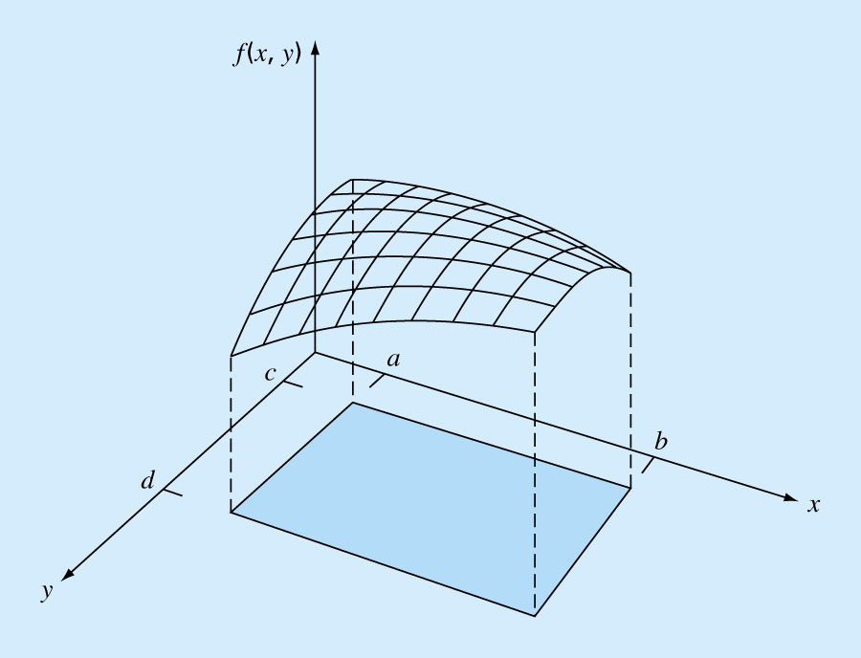
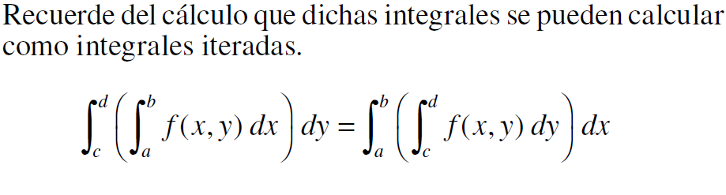
Multiple Integration
Double integral:
Primero se evalúa la integral en una de las dimensiones y el resultado de esta primera integración se incorpora en la segunda dimensión.

Slide 25
Double integral - Example
Compute the average temperature of a rectangular heated plate which is 8m long in the x direction and 6 m wide in the y direction. The temperature is given as:
(Use 2 segment applications of the trapezoidal rule in each dimension)

Slide 26
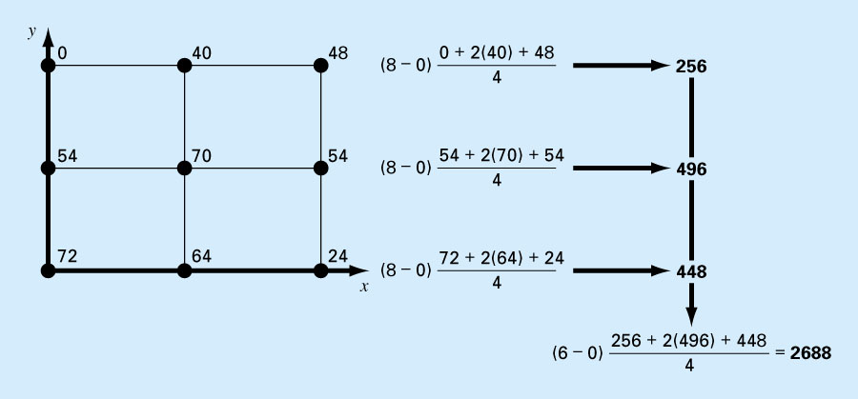
Double integral - Example
HW: Use two points Gauss formula to solve the problem

Slide 27
Integration with Unequal Segments
Previous formulas were simplified based on equispaced data points - though this is not always the case.
The trapezoidal rule may be used with data containing unequal segments:

Slide 28
Integration with Unequal Segments
Using Trapezoidal Rule
Example 21.7
which represents a relative error of ε = 2.8%
x | f(x) | x | f(x)
0.0 | 0.2 | 0.44 | 2.842
0.12 | 1.309 | 0.54 | 3.507
0.22 | 1.305 | 0.64 | 3.181
0.32 | 1.743 | 0.70 | 2.363
0.36 | 2.074 | 0.80 | 0.232
0.40 | 2.456
Data for
f(x)= 0.2+25x-200x²+675x³-900x⁴+400x⁵

Slide 29
Integration Code for Unequal Segments
function I = trapuneq(x,y)
% trapuneq: unequal spaced trapezoidal rule quadrature
% I = trapuneq(x,y):
% Applies the trapezoidal rule to determine the integral
% for n data points (x, y) where x and y must be of the
% same length and x must be monotonically ascending
% input:
% x = vector of independent variables
% y = vector of dependent variables
% output:
% I = integral estimate
if nargin<2,error('at least 2 input arguments required'),end
if any(diff(x)<0),error('x not monotonically ascending'),end
n = length(x);
if length(y)~ = n,error('x and y must be same length'); end
s = 0;
for k = 1:n − 1
s = s + (x(k+l) − x(k))*(y(k)+ y(k +l))/2;
end
I = s;

Slide 30
MATLAB Functions
MATLAB has built-in functions to evaluate integrals based on the trapezoidal rule
z = trapz(y) z = trapz(x, y) produces the integral of y with respect to x. If x is omitted, the program assumes h=1.
z = cumtrapz(y) z = cumtrapz(x, y) produces the cumulative integral of y with respect to x. If x is omitted, the program assumes h=1.

Slide 31






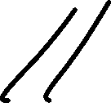





Slide 32
Numerical Integration in MATLAB
Q = INTEGRAL(FUN,A,B) approximates the integral of function FUN from A to B using global adaptive quadrature and default error tolerances.
function Q = integral2(fun,xmin,xmax,ymin,ymax,varargin)
% INTEGRAL2 Numerically evaluate double integral.
% Q = INTEGRAL2(FUN,XMIN,XMAX,YMIN,YMAX) approximates the integral of
% FUN(X,Y) over the planar region XMIN <= X <= XMAX and YMIN(X) <= Y <=
% YMAX(X). FUN is a function handle, YMIN and YMAX may each be a scalar
% value or a function handle.

Slide 33
MATLAB Functions: integral2 and integral3
MATLAB has functions to implement both double (integral2) and triple (integral3) integration. A simple representation of the syntax for integral2 is:
where q is the double integral of the function fun over the ranges from xmin to xmax and ymin to ymax.
>> q = integral2(@(x,y) 2*x*y + 2*x − x.^2 − 2*y.^2 + 72,0,8,0,6)
q =
2816

Slide 34
Compute Integrals Using MATLAB
First, create a file called fx.m which contains f(x):
function y = fx(x)
y = 0.2+25*x-200*x.^2+675*x.^3-900*x.^4+400*x.^5 ;
>> x=[0 .12 .22 .32 .36 .4 .44 .54 .64 .7 .8]
>> y = fx(x)
y = 0.200 1.309 1.305 1.743 2.074 2.456
2.843 3.507 3.181 2.363 0.232
>> Integral = trapz(x,y) % or trapz(x, fx(x))
Integral =1.5948
x | f(x) | x | f(x)
0.0 | 0.2 | 0.44 | 2.842
0.12 | 1.309 | 0.54 | 3.507
0.22 | 1.305 | 0.64 | 3.181
0.32 | 1.743 | 0.70 | 2.363
0.36 | 2.074 | 0.80 | 0.232
0.40 | 2.456

